Slide 1
MOB DEVICES VUL & MITIGATION
Lesson 61
Intro : Mob Device Security
Last Updation Dt : 08 Jan 25

Slide 2

LESSON PREVIEW
Intro to Mob OS Arch
File Structure
Versions
Security Features
Current Mkt Ldrs
Comparison of Apps
Tracking Vulnerabilites in Smart Phs

Slide 3
PD 2 : MOB OS VERSIONS & SECURITY FEATURES

Slide 4
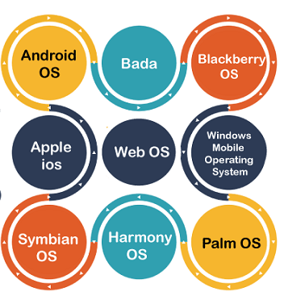
MOB OS

Slide 5


ANDROID OS VERSIONS
ANDROID OS VERSIONS

Slide 6
ANDROID OS VERSIONS
https://www.youtube.com/watch?v=vjSvC7OTHOI

Slide 7
ANDROID OS SECURITY FEATURES
Appln Sandbox
App Signing
Auth
Biometrics
Encryption
Keystore
Security-Enhanced Linux
Trusty Trusted Exec Envt (TEE)
Verified Boot

Slide 8
ANDROID OS SECURITY FEATURES : APPLN SANDBOX
Android platform takes advantage of the Linux user-based protection.
Identifies and isolate app resources.
Android assigns a unique user ID (UID) to each Android app and runs it in its own process.
UID is used to set up a kernel-level Application Sandbox.

Slide 9
ANDROID OS SECURITY FEATURES : APP SIGNING
Allows developers to identify the author of the app.
Allows developers to update their app without creating complicated interfaces and permissions.
Every app that runs on the Android platform must be signed by the developer.

Slide 10
ANDROID OS SECURITY FEATURES : AUTH
Android uses the concept of user-authentication-gated cryptographic keys that requires cryptographic key storage and service provider and user authenticators.
On devices with a fingerprint sensor, users can enroll one or more fingerprints and use those fingerprints to unlock the device and perform other tasks.
Gatekeeper subsystem performs device pattern or password authentication in a Trusted Execution Environment (TEE).
Android 9 and higher includes Protected Confirmation, which gives users a way to formally confirm critical transactions, such as payments.

Slide 11
ANDROID OS SECURITY FEATURES : BIOMETRICS
Android 9 and higher includes a BiometricPrompt API that app developers can use to integrate biometric authentication into their apps in a device- and modality-agnostic fashion.
Only strong biometrics can integrate with BiometricPrompt.

Slide 12
ANDROID OS SECURITY FEATURES : ENCRYPTION
Once a device is encrypted,
All user-created data is automatically encrypted before committing it to disk.
All reads automatically decrypt data before returning it to the calling process.
Encryption ensures that even if an unauthorized party tries to access the data, they can't read it.

Slide 13
ANDROID OS SECURITY FEATURES : KEYSTORE
Android offers a hardware-backed Keystore
Functions of Keystore.
Key genr
Import and export of asymmetric keys
Import of raw symmetric keys
Asymmetric encryption and decryption with appropriate padding modes

Slide 14
ANDROID OS SECURITY FEATURES : SECURITY-ENHANCED LINUX
Android uses Security-Enhanced Linux (SELinux)
Enforces mandatory access control (MAC) over all processes
Applicable to even processes running with root or superuser privileges (Linux capabilities)

Slide 15
ANDROID OS SECURITY FEATURES : TRUSTY TRUSTED EXEC ENVT
Trusty.
Secure OS.
Provides a Trusted Exec Envt for Android.
Runs on the same processor as the Android OS.
However, Trusty is isolated from the rest of the system by both hardware and software.

Slide 16
ANDROID OS SECURITY FEATURES : VERIFIED BOOT
Strives to ensure all executed code comes from a trusted source.
Trusted source is usually device OEMs.
Prevents exec of code from an attacker or corruption.
Ests a full chain of trust amongst booting components.

Slide 17
REFS
Android security features
https://source.android.com/docs/security/features

Slide 18
JAI HIND

